Slide 1



SP-25
Lecture No.01
Course: Expository Writing
Instructor: Ms. Asma Masood

Slide 2
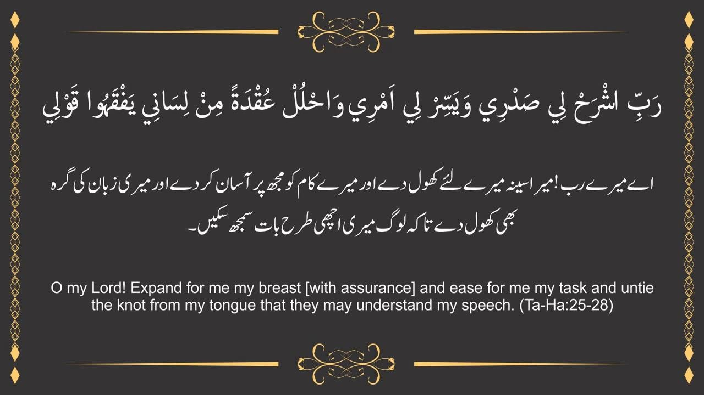

Slide 3





Road Map-Lecture Contents
Introduction
Students
Teacher
Definition, types and purpose of Expository Writing
Course Contents

Slide 4

Get acquainted with each other!

Slide 5
Teacher’s Profile
Asma Masood(LECTURER IN DBA)
(MS / M. Phil English Literature) Email: asma.masood@iqrauni.edu.pk
Previous Employment
Lecturer at Arid Agriculture University, Rawalpindi
Lecturer at Fazaia Bilquis Postgraduate College, Nur Khan Base Rawalpinidi

Slide 6
Course Details
Course Name: Expository Writing
Contact Hours: Theory: 48
Credit Hours: Theory: 3
Pre – Requisite: Functional English

Slide 7
Course Description
This course is designed to equip students with essential language skills for effective communication in diverse real-world scenarios. It focuses on developing proficiency in English language usage: word choices, grammar and sentence structure.
In addition, the course will enable students to grasp nuanced messages and tailor their communication effectively through application of comprehension and analytical skills in listening and reading.
Moreover, the course encompasses a range of practical communication aspects including professional writing, public speaking, and everyday conversation, ensuring that students are equipped for both academic and professional spheres.
An integral part of the course is fostering a deeper understanding of the impact of language on diverse audiences.
Students will learn to communicate inclusively and display a strong commitment to cultural awareness in their language use. Additionally, the course will enable them to navigate the globalized world with ease and efficacy, making a positive impact in their functional interactions.

Slide 8
Course Objectives
Objective 1: Introduce students to key communication principles , enabling them to communicate effectively in both verbal and written forms.
Objective 2: Help students to understand the writing process which includes pre- writing techniques, drafting, revising and editing, proofreading, peer review and feedback.
Objective 3: Introduce students to different types of expository writing: Description, Illustration, Classification, Cause and effect, Process analysis and Comparative analysis.
Objective 4: Demonstrate linguistic flexibility by adjusting communication styles to fit diverse cultural and social situations.

Slide 9
Course Learning Outcomes CLOs
 | Sr. No. | CLOs Statement | Taxonomy Levels | PLOs
 | Sr. No. | CLOs Statement | Taxonomy | PLOs
 |  |  | Levels
Course Learning | 1 | Understand the essentials of the writing process through a series of steps. | C2 | 5
 | 2 |  | C3 | 6
Outcomes |  | Practice writing to refine their macro level
(CLOs) and |  | as well as micro level compositional skills.
Targeted PLOs: | 3 | Employ various rhetorical modes like arguments, narration, description, comparison and contrast exemplification | C4 | 3
 |  | in their writing.
10/22/2024
9

Slide 10
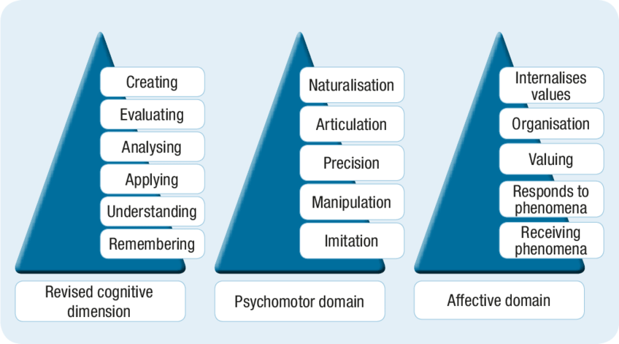
Taxonomy Levels

Slide 11
Course Weight Breakdown
Assessment Instruments with Weight
Task/Activities | Frequency | Weightage
Assignment | 3 | 10%
Quiz | 4 | 10%
Presentation | 1 | 10%
Midterm Examination | 1 | 30%
End Term Examination | 1 | 40%

Slide 12
Grading
Grade | Percentage | Points | Remarks
A+ | 90% - 100% | 4 | Excellent
A- | 85% - 89% | 3.75 | Very Good
B+ | 80% - 84% | 3.5 | Good
B- | 70% - 74% | 3.25 | Average
C+ | 65% - 69% | 3 | Average
C | 60%-64% | 2.75 | Below Average
C- | 56%-59% | 2.5 | Below Average
W | 53%-55% | 2.25 | pass
K | 50%-52% | 2 | pass

Slide 13
Recommended Books
Text & Reference Books
  Focus will be on topics rather Chapters of any text.
  Many Textbooks are available in the market.
Recommended Textbooks
BOOK1:“Technical Communication: Process and Product”, Seventh Edition by Sharon J. Garson and Steven M. Gerson
BOOK2: Effective Communication Skills: The Foundations for Change, John Nielsen, 2008, ISBN = 1453506748
BOOK3:
Hutchinson, E. (2012). Expository Writing. California:
Saddleback Educational

Slide 14

Course Contents
Principles of writing good English
Composition process: writing clearly
Words, sentences and paragraphs
Comprehension and Expression
Use of grammar and punctuation
Process of writing, observing audience, collecting data, composing, drafting
and revising.
14
C
10/22/2024
14
14
14

Slide 15
Course Contents
Reading strategies (skimming, scanning, SQ4R, critical reading, etc.)
Active listening (overcoming listening barriers, focused listening, etc.)
Persuasive writing
Skill for taking notes in the class
Business Communication, Letter writing, memo, emails
Writing Resumes
Effective presentation Skills
10/22/2024
15

Slide 16

Introduction to Expository Writing
10/22/2024 16
10/22/2024
16

Slide 17
Introduction
Expository writing is a type of writing that aims to explain, describe, or inform the reader about a particular topic. Its purpose is to convey information clearly and objectively without the author's personal opinions or emotions. Common forms of expository writing include essays, how-to write articles, textbooks, reports, and news articles.
Key features of expository writing include:
Clarity and focus: The writing is straightforward and easy to understand.
Structured format: It typically follows a logical structure with an introduction, body paragraphs,
and conclusion.
Objective tone: The writer remains neutral, presenting facts or explanations without bias.
Evidence-based: Supporting details, facts, and examples are used to reinforce the explanation.
This type of writing is common in academic, professional, and educational settings where the goal is to inform or instruct.

Slide 18
Key purposes of Expository writing
To Explain a process
To provide information
To compare and contrast
To define a concept

Slide 19
Key purposes
Examples:
To Explain a process: It is used to explain how something works or how to do something. For example, a manual on "How to Bake a Chocolate Cake" would give step-by-step instructions, listing ingredients and methods without adding any personal flair or opinions.
To Define a Concept: It is used explains the meaning of a word or concept in detail, often breaking it down for better understanding. For example, the word ‘Democracy’. It is a form of government where power lies in the hands of the people.

Slide 20
Types of Expository writing
Descriptive: Describes something in detail.
Process: Explains how to do something.
Comparison and Contrast: Highlights similarities and differences.
Cause and Effect: Examines reasons and outcomes.
Problem and Solution: Identifies an issue and offers solutions.
Definition: Provides a detailed explanation of a term.
Classification: Breaks down a topic into categories.
Analytical: Analyzes parts of a subject.
Each type of expository writing is used to convey specific information in a clear, structured manner, making it accessible for readers to understand and engage with the content.

Slide 21
Types and Examples
Descriptive Essay
A descriptive expository essay provides detailed information about a person, place, object, or event. Its goal is to paint a vivid picture in the reader’s mind, using specific facts, features, and characteristics without inserting personal opinions or emotions.
Example:
A descriptive essay on the Grand Canyon might provide details about its size, geological history, layers of rock, and the vibrant colors that change with the sunlight throughout the day.

Slide 22
Types and Examples
Comparison and Contrast Essay
This type of expository writing highlights the similarities and differences between two or more subjects. It can either present both subjects simultaneously (point-by-point) or discuss each subject separately (block method).
Example:
An essay comparing traditional classrooms with online learning would examine how both methods handle factors like flexibility, cost, and the learning environment.

Slide 23
Types and Examples
Cause and Effect Essay
A cause and effect essay explains the reasons why something happened (the cause) and the resulting outcomes or consequences (the effect). This form is often used to analyze situations or historical events.
Example:
An essay on the causes and effects of pollution might explore the industrial activities leading to air pollution and the subsequent effects on human health and climate change.

Slide 24
Types and Examples
Problem and Solution Essay
This type of essay identifies a problem, provides background information on the issue, and then presents potential solutions. It often includes a discussion of the pros and cons of each solution.
Example:
An essay on the problem of plastic waste might discuss its environmental impact and offer solutions like increased recycling efforts, banning single-use plastics, and promoting biodegradable alternatives.

Slide 25

Any Queries?

